Slide 1
Plan for AC Project
Jackson Holland

Slide 2
Goal
The goal of this plan is to organize future efforts for the Shellfish Counting/Classification model, so that we can systematically improve the current model while making use of the existing work.

Slide 3
System for Model Improvement
This system was designed by Andrew Ng, who is a professor at Stanford, founder of DeepLearning.AI, CEO of Landing AI, General Partner at AI Fund, Co-Founder of Coursera, Former Chief Scientist at Baidu, and founding lead at Google Brain.

Slide 4
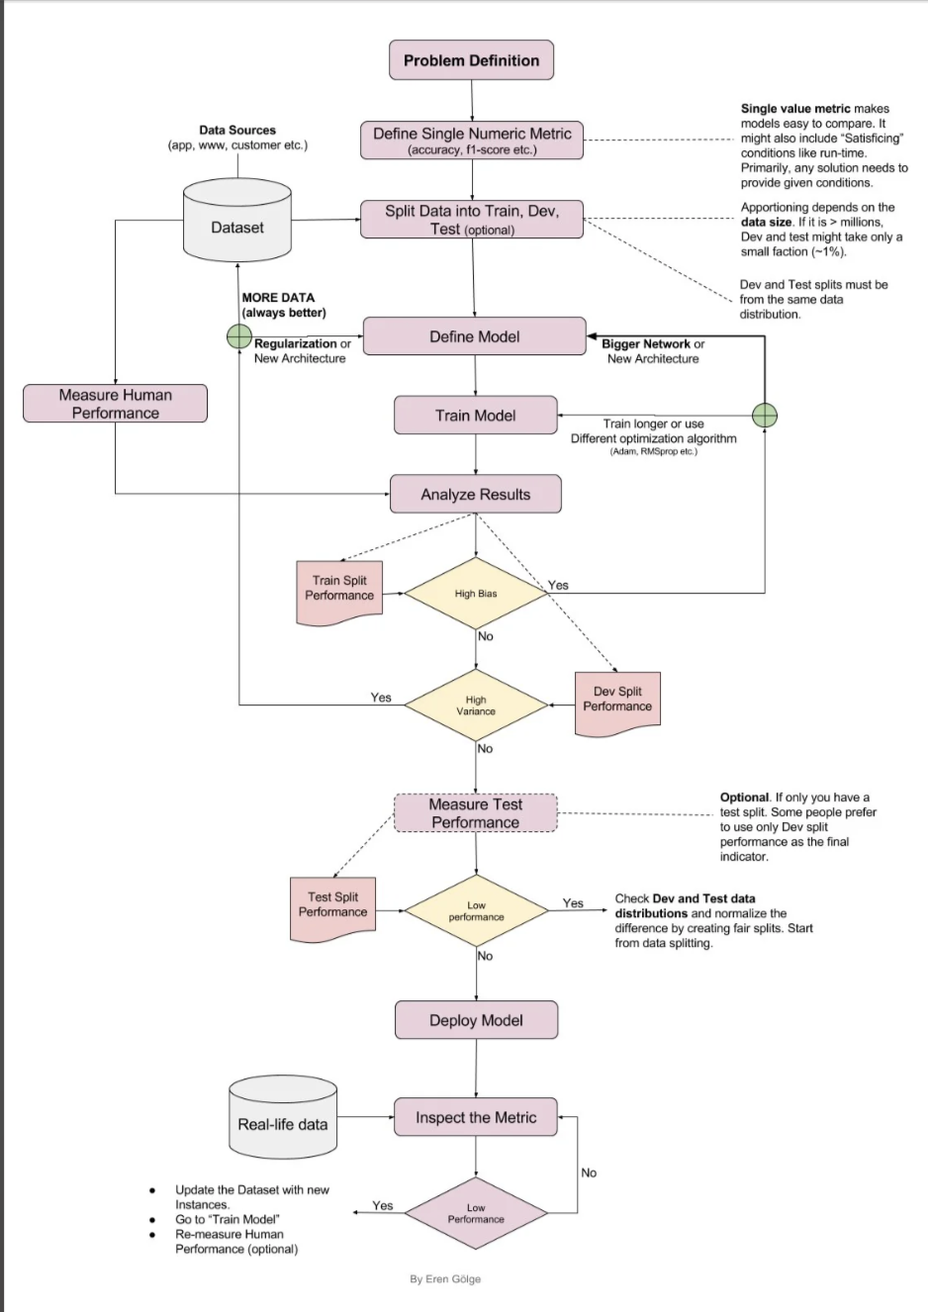

Slide 5
Note About Metric
While using one metric helps iterate quickly and systematically, no metric is perfect, so it is important to do error analysis as well to get a more holistic view of performance.
Error analysis means looking at instances where the model made an incorrect prediction. For instance, you might notice that the model performs poorly on blurry images, which a metric might not tell you. You could then implement data augmentations to make the model train on more blurry images.

Slide 6
Problem Definition
Count and classify the number of healthy and dead larvae in an image taken under a microscope.
This can be split into two problems:
Identify the larvae (object detection)
Classify the larvae (classification)
We can use the previously mentioned system to iterate on a model for each of the two problems.
We can use an overall metric that measures the performance of the overall pipeline.

Slide 7
Object Detection

Slide 8
Sub-problem Definition
Identify instances of Larvae in an image taken under a microscope.

Slide 9
Single Numerical Metric for Object Detection
AP (area under the Precision-Recall curve)
We can use this for our object detection problem, as it focuses solely on the quality of predicted bounding boxes across multiple thresholds.

Slide 10
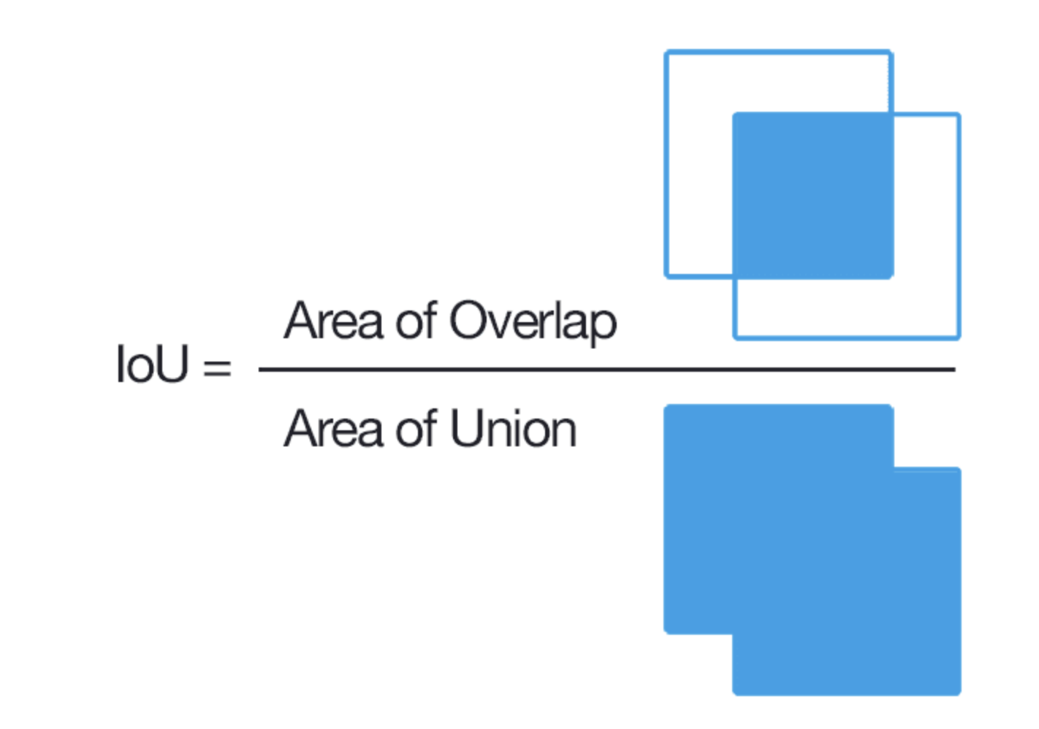
Explanation of IoU (Intersection over Union)
IoU is essentially calculated by counting the number of pixels that are in both the ground truth bounding box and the predicted bounding box (area of overlap aka intersection) and dividing this by the number of pixels that are in one of the boxes, or in both (area of union).

Slide 11
How AP is calculated
Area of Overlap
Ground Truth Bounding Box
Predicted Bounding Box
True Positive (TP)
We have a True Positive if the IoU of a ground truth bounding box and a predicted bounding box is above or equal to the IoU threshold (popular thresholds are 0.5 or 0.75).

Slide 12
How AP is calculated
Area of Overlap
Ground Truth Bounding Box
Predicted Bounding Box
False Positive (FP)
We have a False Positive when a predicted bounding box has an IoU less than the threshold with any ground truth bounding box.
OR
OR

Slide 13
How AP is calculated
Area of Overlap
Ground Truth Bounding Box
Predicted Bounding Box
False Negative (FN)
We have a False Negative when a ground truth bounding box does not have any predicted bounding boxes with an IoU greater than or equal to the threshold.
OR
OR

Slide 14
Clarifications About FN vs FP
You might wonder what the difference between FP and FN since they have the same diagrams.
The key is that an FP occurs when the model predicts a bounding box where there is no corresponding ground truth bounding box whose IoU with the predicted bounding box is greater than or equal to the threshold.
An FN occurs when we have a ground truth bounding box with no corresponding predicted bondings boxes with an IOU greater than or equal to the threshold.
FN focuses more on the ground truth bounding boxes, and FP focuses more of predicted bounding boxes.
An FP means the model “hallucinates” an object that is not there, and a FN means the model misses an object.

Slide 15
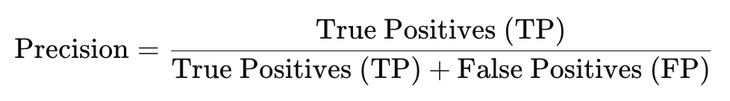
Precision
A high precision means that the model makes few mistakes when it predicts positive for the class.
A low precision means that the model makes a lot of mistakes when predicting the positive class (ie a lot of false positives).

Slide 16
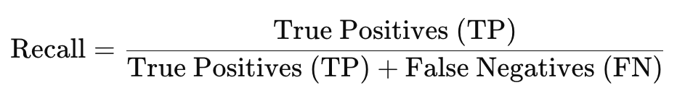
Recall
A high recall means the model detects most of the actual objects.
A low precision means that the model misses many real objects (ie lots of false negatives)

Slide 17
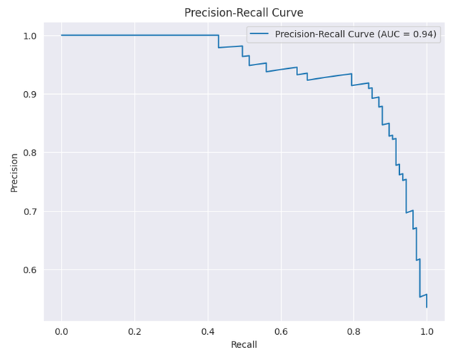
AP (area under the Precision-Recall curve)
Step 1: Calculate the Precision and Recall for a bunch of different IoU thresholds and plot these values with Recall on x-axis and Precision on y-axis.
Step 2: Take the area under the resulting curve. This is the AP.

Slide 18
mAP (Mean Average Precision)
This is an average of the mAP for each class, where each class if weighted equally.
This gives us a good idea of how the model is detecting objects, while giving equal weight to both classes.

Slide 19
Classification

Slide 20
Sub-problem Definition
Classify the content of predicted bounding boxes as healthy or dead larvae.

Slide 21
Single Numerical Metric for Object Detection
Macro F1
We have an imbalanced dataset, and we want to give equal weight to each class so that we can make sure that our classification model is not biased. Macro F1 considers the performance of each class independently and averages them, giving equal weight to each class.

Slide 22
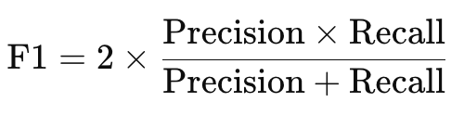
Macro F1 Calculation
We calculate the F1 score for each class:
We then take the average of the F1 across all classes to calculate F1, which ensures that each class is weighted equally.

Slide 23
Overall Metric

Slide 24
Problem
The previously mentioned metrics measure the performance of the individual sub problems, but they don’t directly measure the performance of the core problem, which is to count the number of healthy and dead larvae in an image.

Slide 25
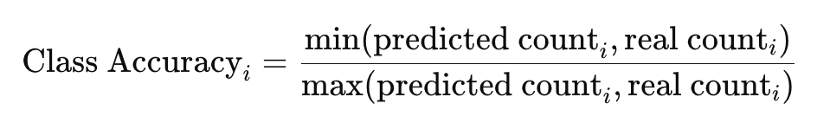
Proposed Solution
Define a custom metric that measure how accurately we are counting the number of dead or healthy larvae.
For each class, we can define:
We can then take an average of these scores, giving equal weight to each class. This will directly indicate how well our pipeline is predicting the correct number of healthy and dead larvae.
The closer the average is to 1, the better.
The min and max ensure that we handle cases of both undercounting and overcounting

Slide 26
Set Up Table on Github to Organize Results
For each change to the model, we should collect the resulting evaluation metric scores, and input them into the Github table, which can be placed in the README file or Google Drive for easy access.

Slide 27
What the Table Will Look Like
Object Detection | AP | Model Details
o0.1 | .67 | Architecture: YOLO Changes: NA (baseline)
o0.2 | .82 | Architecture: YOLO Changes: Trained for an additional 50 epochs

Slide 28
What the Table Will Look Like
Classification | Macro F1 | Model Details
c0.1 | .67 | Architecture: SVM Changes: NA (baseline)
c0.2 | .82 | Architecture: ResNet Changes: Changed architecture

Slide 29
What the Table Will Look Like
Pipeline | Average Class Count Accuracy | Model Details
o0.1 + c0.1 | .81 | Changes: NA (baseline)
o0.2 + c0.1 | .99 | Changes: Changed object detection model.
Note: o0.1 indicates that the pipeline uses version o0.1 for object detection, and c0.1 indicates that the pipeline uses version c0.1 for classification

